Slide 1
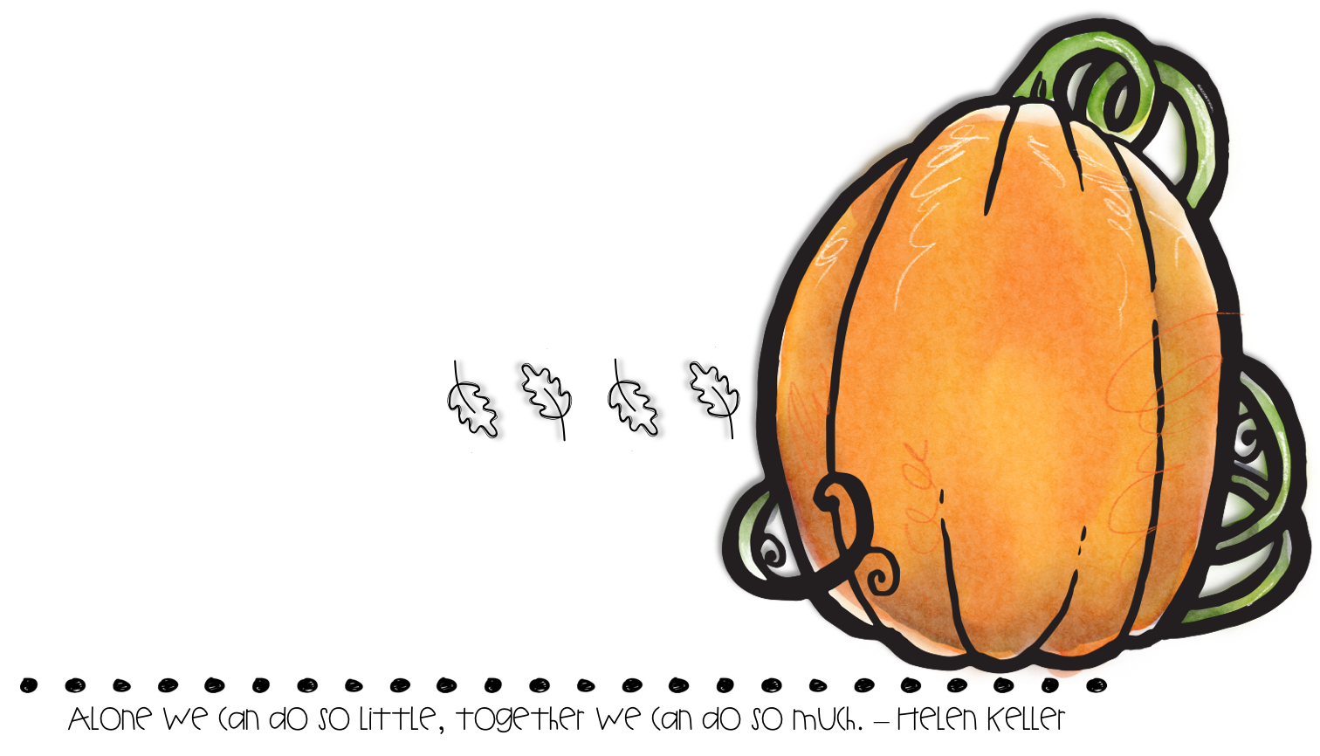
OCTOBER
We have survived the first month of school. I have really enjoyed getting to know your children. They have all been working so hard.
We will begin weekly homework, this is just meant to be a way to tie instruction into our homes! If your child is struggling please just let me know, we will come up with another plan. Students will have 1 math activity, 1 ELA activity, and a home fun activity each week. Let me know if you have any questions
Please feel free to call or email me if you have any questions or concerns.
585-482-9290 X1170
Meghan.Mirrione@rcsdk12.org
We have mastered most of our rituals and routines.
ELA- We are working on letter identification, sequencing events, listening to stories, and answering comprehension questions
Math- Groups have been working on number identification and counting. We are working on more and less.
Social Studies- Community Helpers
Weekly homework starts this week!
Please sign up for classroom dojo. I plan on putting pictures up and using this is a communication tool throughout the year! It’s also great if you need to message us throughout the day!
Parent teacher conferences are coming, I will send a letter home to schedule a time!
October 1st- Timothy’s birthday
October 2nd- Fire Dept Visit
October 3rd- Izaiyah’s birthday
October 11th & 14th- No School
October 31st- Halloween & Hopefully Field Trip to Fire House

